Slide 1
The Fastest Growing Workstation Manufacturer Worldwide LENOVO NUMBER ONE PC MANUFACTURER WORLDWIDE
We enable dreamers and storytellers

Slide 2
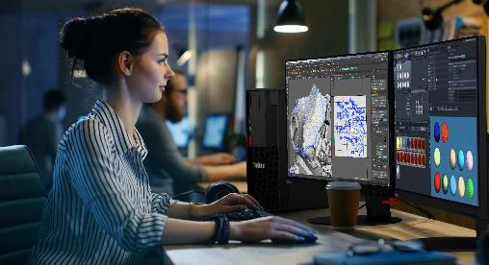
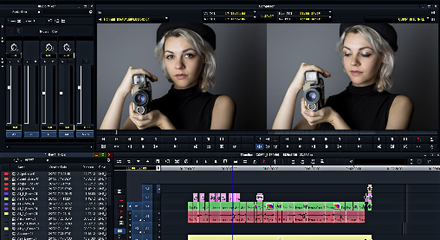
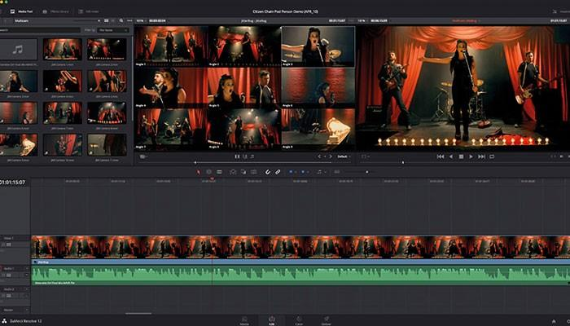
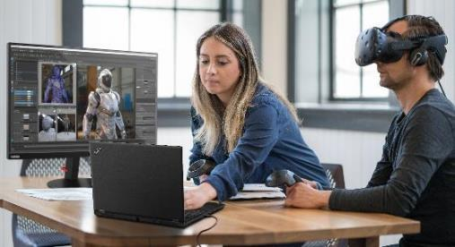
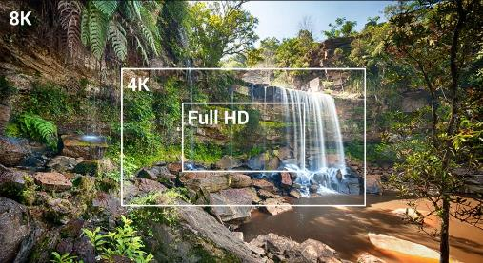
DOES YOUR PRODUCTION REQUIRE WORKSTATIONS FOR…
2D & 3D Animation
Editing
Finishing
AR & VR
AI
8k

Slide 3
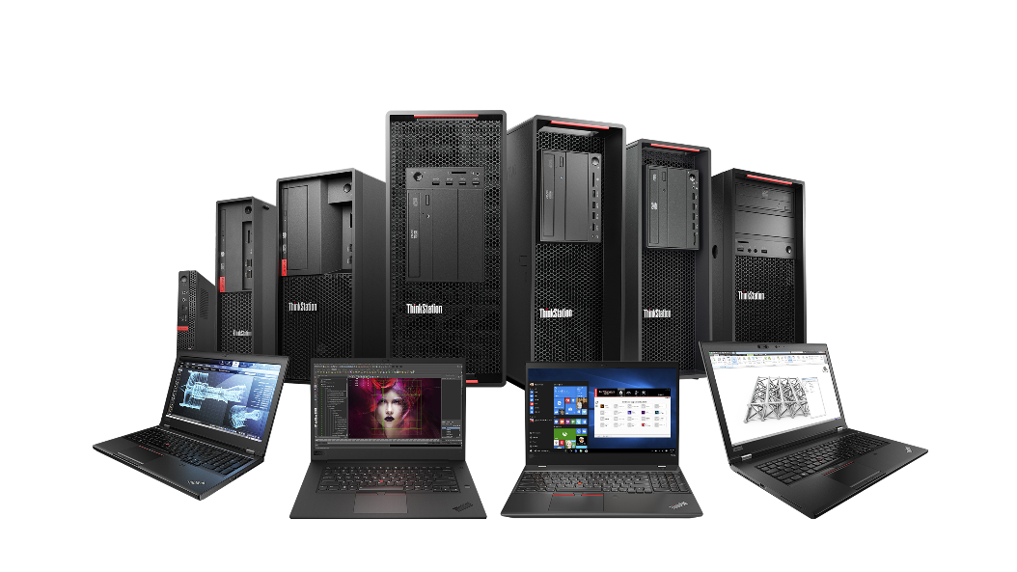
HOW LENOVO WORKSTATIONS CAN HELP
Workstation portfolio for any M&E workflow
The breadth and depth of the Lenovo workstation portfolio makes it easy for you to select the right workstation to meet your production requirements, whether you are doing 2D/3D animation, compositing, editing or color correction.
It’s critical for you to meet and exceed your clients expectations, and do so on time and on budget. This is why more artists and production facilities are turning to Lenovo workstations to ensure creativity capabilities are never compromised, while maximizing their production efficiency and pipeline reliability.
M&E
Software Solutions
Get the most out of your M&E applications with Lenovo Performance Tuner (LPT).
Troubleshoot and minimize downtime with Lenovo Diagnostics.
Maximum Security
ThinkShield by Lenovo is the most complete security suite for business. From start to finish, we ensure your device is secure from every angle.
Customer Solutions
Benchmarking and configuration optimization to help you pick the right Lenovo solution for your requirement.
Designed in the USA
Lenovo workstations are designed in North Carolina, United States.
Power & Reliability
Lenovo workstations have the power and performance to take on the most complex M&E workflows.
ISV Certification ISV certification means you can run your M&E applications with confidence.

Slide 4
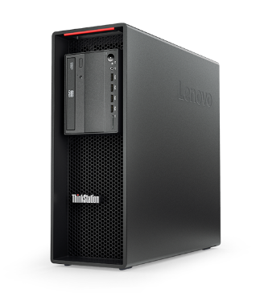
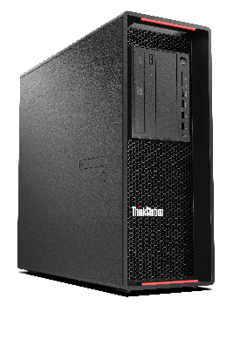
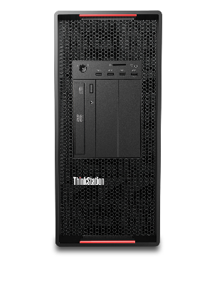
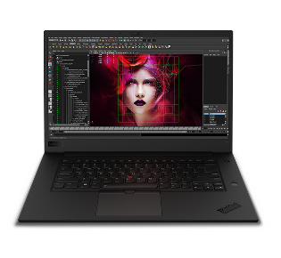
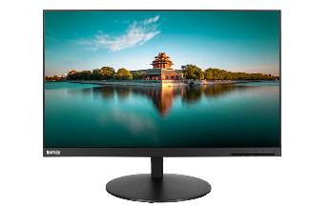
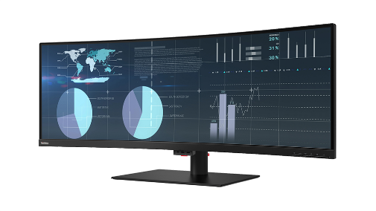
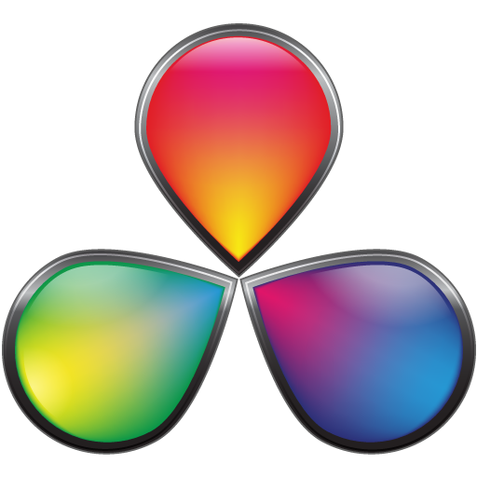
LENOVO WORKSTATIONS FOR M&E PROFESSIONALS
2D & 3D Animation (Ideal for 3ds Max, Maya & Adobe CC)
Complex 2D & 3D Animation + Editing + Creative Finishing
(Ideal for After Effects, Flame, Media Composer, NUKE, Premiere Pro, Resolve, )
(Dual monitor configurations optimize screen real-estate and maximize workflow)
ThinkVision P32u
ThinkPad P1 Gen2
Intel Core i9-9880H
NVIDIA Quadro T2000
32GB RAM
1TB PCIe M.2 Storage
3-Year Warranty
ThinkStation P520 & P520c
Intel Xeon W-2125
NVIDIA Quadro RTX 4000
32GB RAM
2TB PCle M.2 Storage
3-Year Onsite Warranty
Dual ThinkVision P32u
ThinkStation P720
Dual Intel Xeon Gold 6134
NVIDIA Quadro RTX 5000
96GB RAM
2TB PCle M.2 Storage
3-Year Onsite Warranty
Dual ThinkVision P32u
ThinkStation P920
Dual Intel Xeon Gold 6136
NVIDIA Quadro RTX 6000
192GB RAM
2TB PCIe M.2 Storage
3-Year Warranty
Dual ThinkVision P32u
ThinkVision P44w
Notes:
P1, P520 & P520c, P720, P920
P32u, P44w

